Slide 1

Capstone – Gate:Crash
Giovanni E. Martinez
CST-451

Slide 2
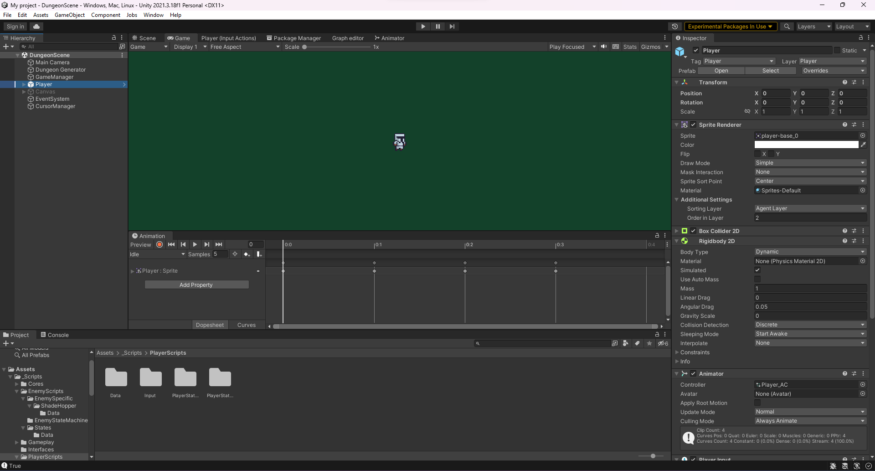
What is Gate:Crash?
2D action-adventure game:
- Orthographic view
Randomly generated maps
Objective based gameplay
Pixel-based art style
Future Plans:
Story quests that build the world

Slide 3
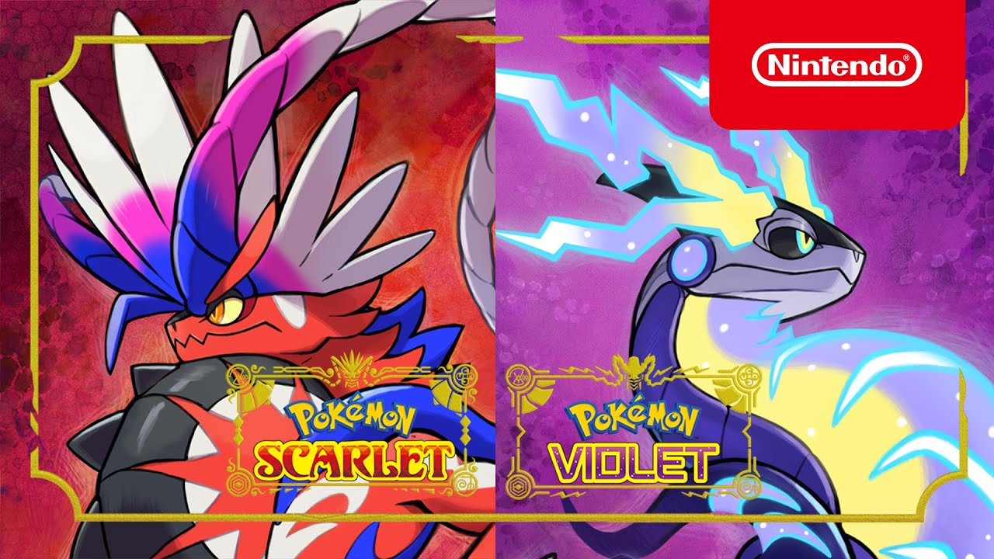
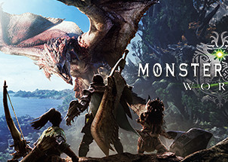
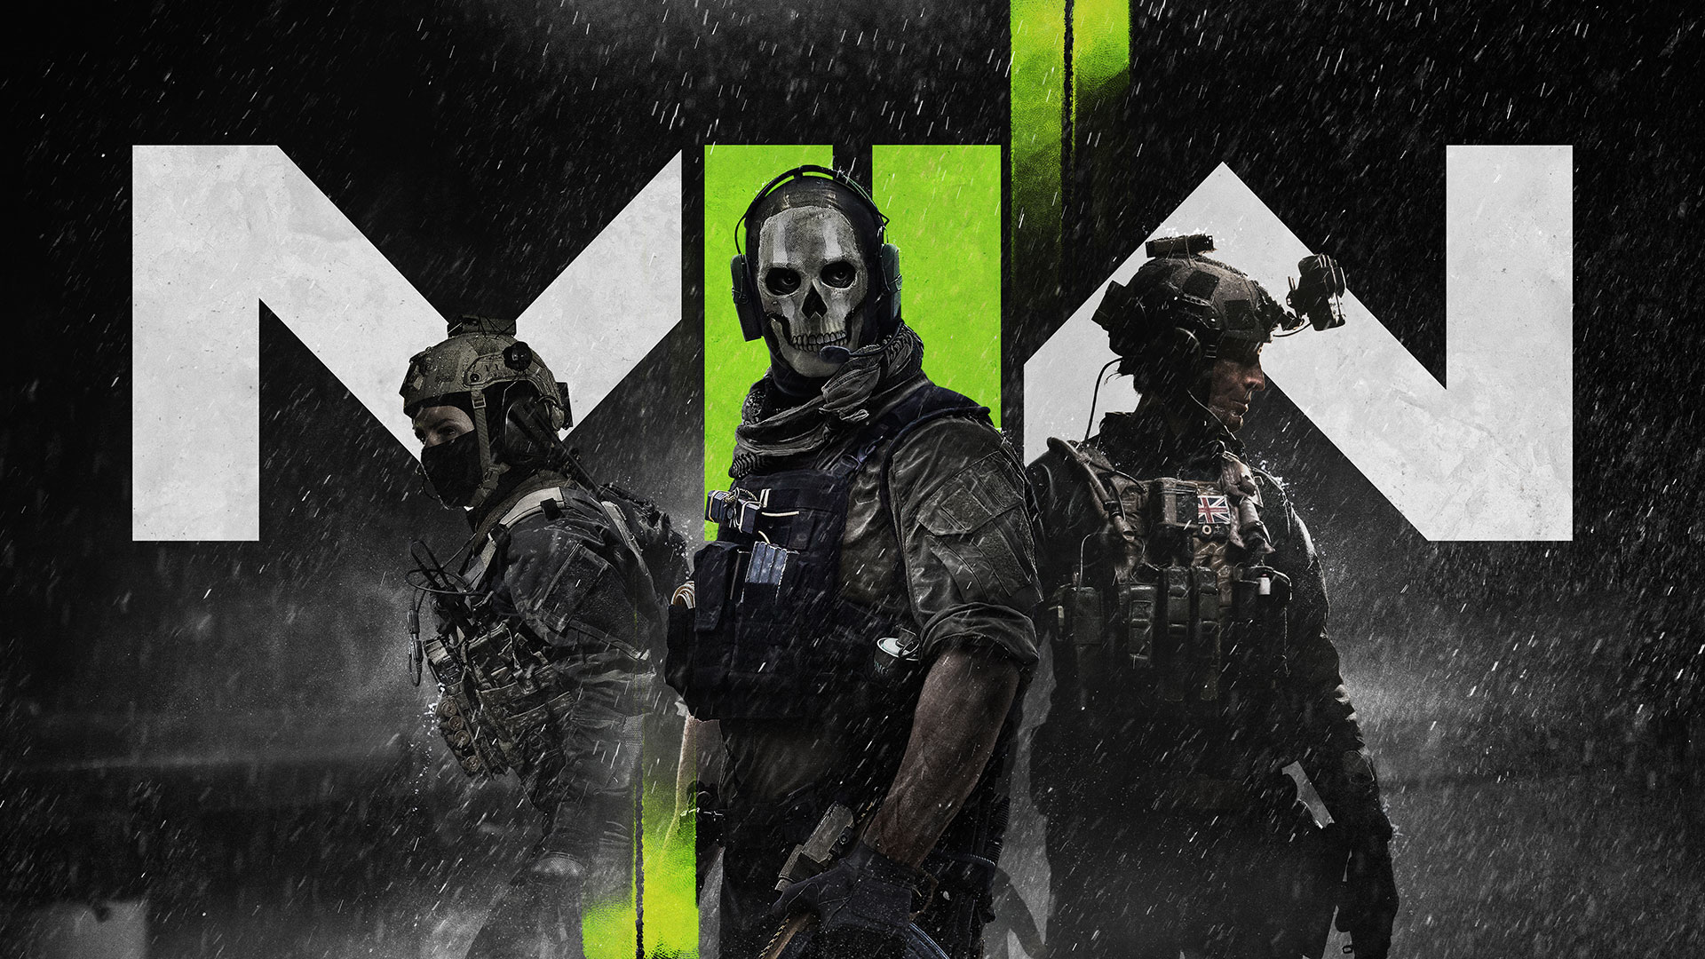
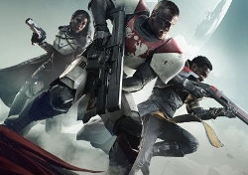
Why?
I aspire to one day become a videogame developer. This project is my opportunity to truly take a dive into building a fully-fledged game from the ground up.
Additionally, I wanted to display my technical capabilities to supplement for my weak design skills.

Slide 4




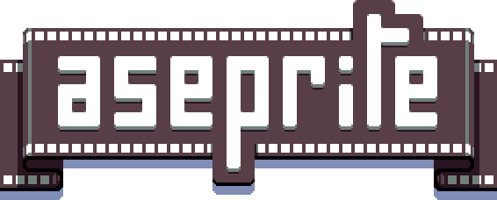


What Technologies?
Unity Real-Time Development Platform
Visual Studio 2022
Visual Studio Code
C#
Aseprite
Audacity, Studio One 5/6

Slide 5
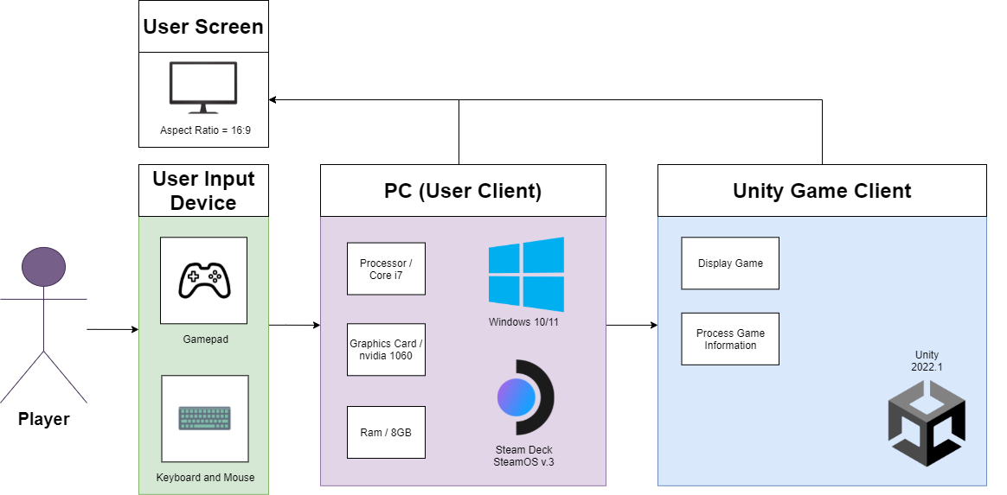
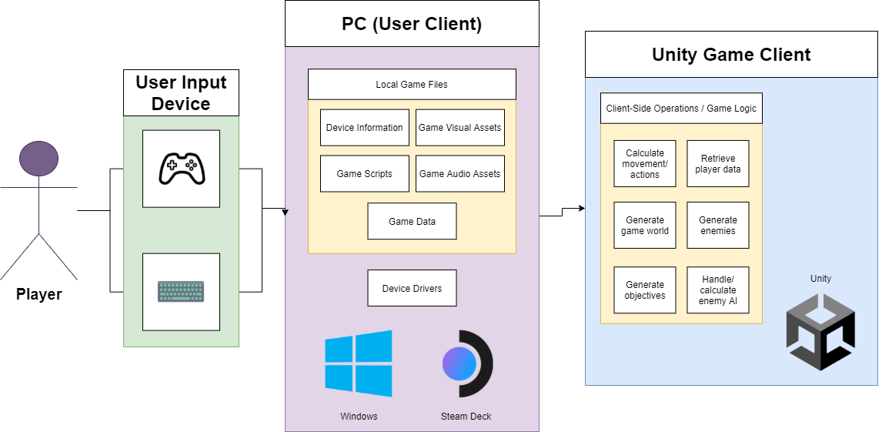
Logical & Physical Design

Slide 6
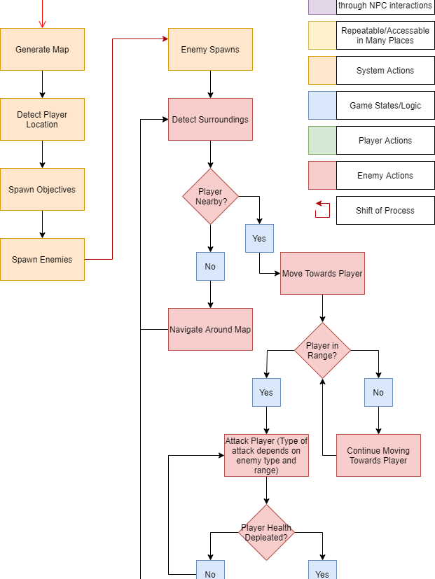
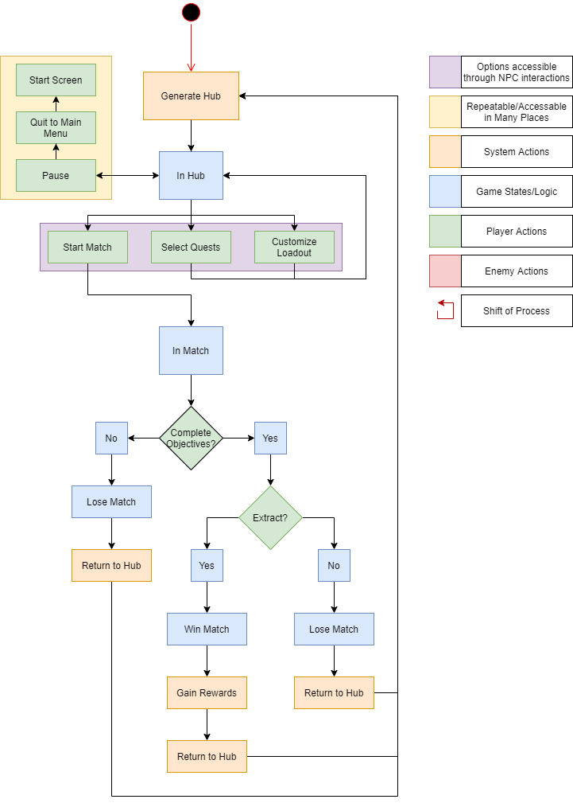
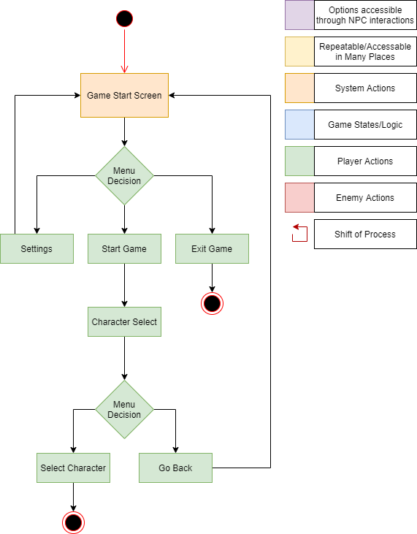
Game Flow

Slide 7
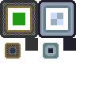
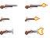
Challenges
Tackling a large development project solo.
Learning new technologies.
Working through SDLC.
Time management.
I am not an artist.

Slide 8
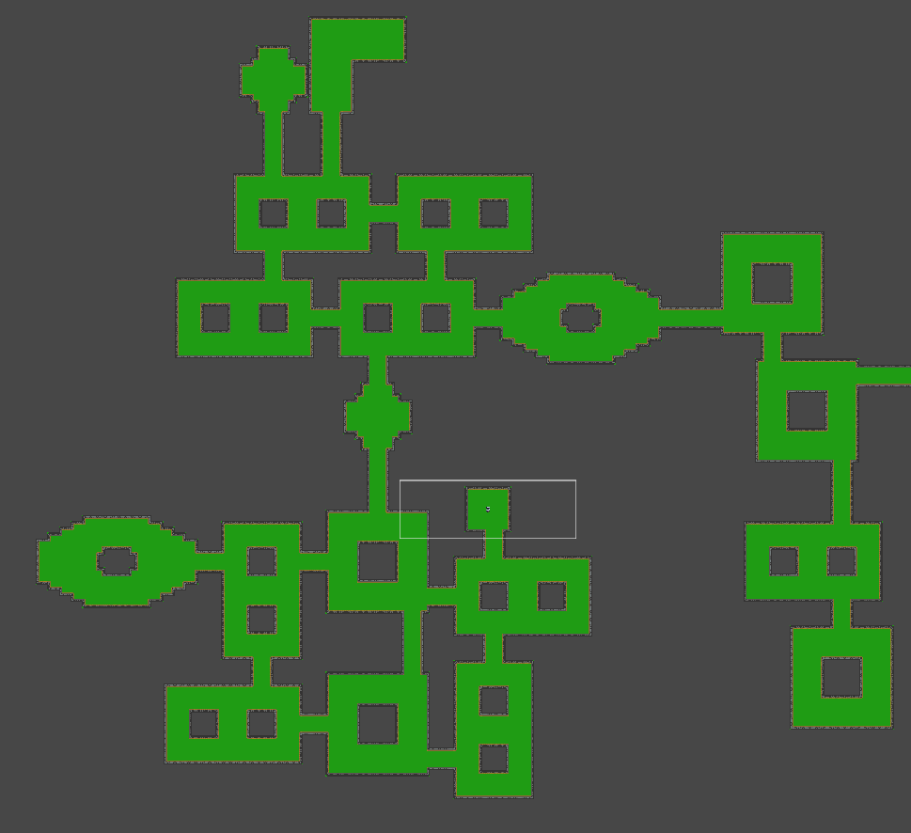
Edgar Dungeon Generator Asset
Allows for the creation of “level graph” objects.
Ability to define individual room templates.
Specify level layout with ease.
Define post processing events for map generation.

Slide 9
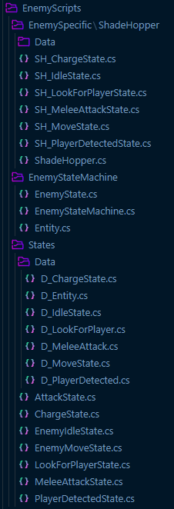
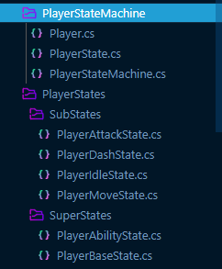
Finite State Machine
Creation of modular Super and Sub states.
Seamless transition between states.
Greater Separation of Concerns.
Easy creation of new entities through prebuilt framework.

Slide 10
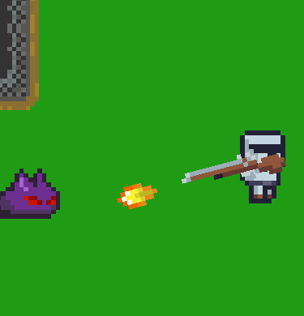
State Machine Challenges
Reduced Flexibility:
Self imposed feature restrictions.
Time consuming to develop.
Transitions between states require some type of input.
Skill Issues:
Not a familiar structure.
First full scope project.

Slide 11
Future Plans / Roadmap
Out of Scope Features
Develop story and world building
Online multiplayer
Character customization
Random loot

Slide 12
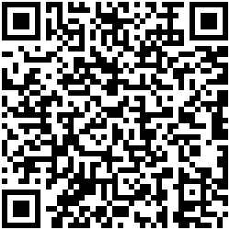
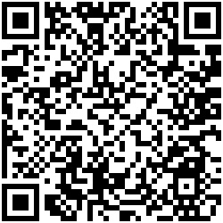
Thank You!
GitHub:
Contact Info:
School Email: gmartinez98@my.gcu.edu
Personal Emails: giovanni.2001@live.com / shogunspade@gmail.com
LinkedIn:

